Slide 1

Stock Data Scraper and Analyzer
By Liam Swain, Kirill Polovtsev, Reilly Swain and Andrew Rose

Slide 2
Introduction
Our team decided to make a application to look up and return certain properties of a chosen stock to the user
We wanted to source the data through web scraping as we were all interested in exploring that topic
Our goal was to have a user input the ticker for a given stock, and have a GUI present information about that stock in a nice visual way

Slide 3
Concept
Collect Current Stock Data by web scraping
Organize data in some meaningful way ( AVL Tree in our case)
Use this formatted data to create tables and organize a database
Use SQL to query the database, returning formatted, user-readable data
Create a main project with aesthetically pleasing visuals to present the data to a user

Slide 4
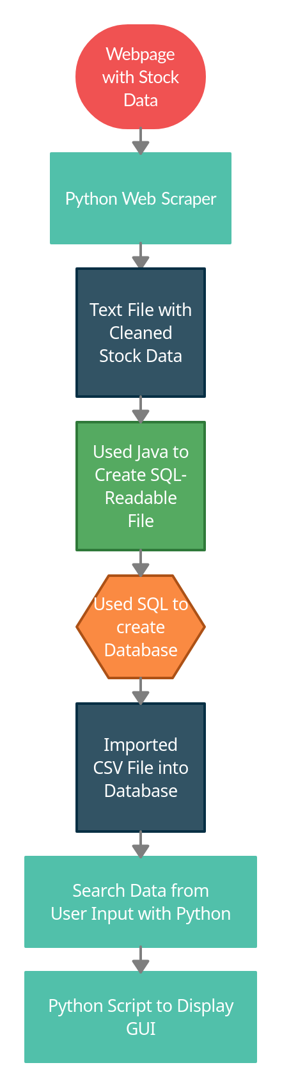
Process

Slide 5
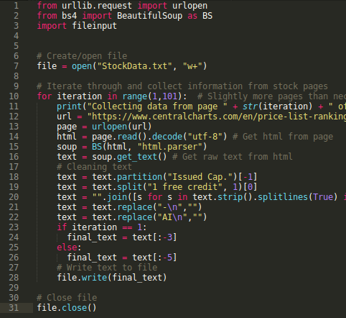
Webscraper
Created in python using the BeautifulSoup urlib.request, and fileinput libraries
Collects current stock data from webpage
There were 100 pages of stock data

Slide 6
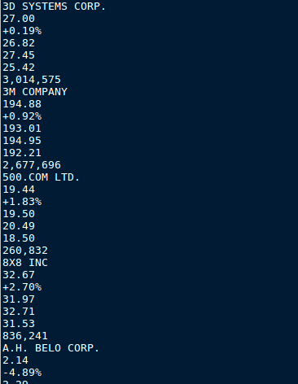
Text File
Cleaned stock data by eliminating all irrelevant pieces of information, and stored it in a text file for processing
Contains stock name, price, net, change, and volume, industry, country and a few more details

Slide 7
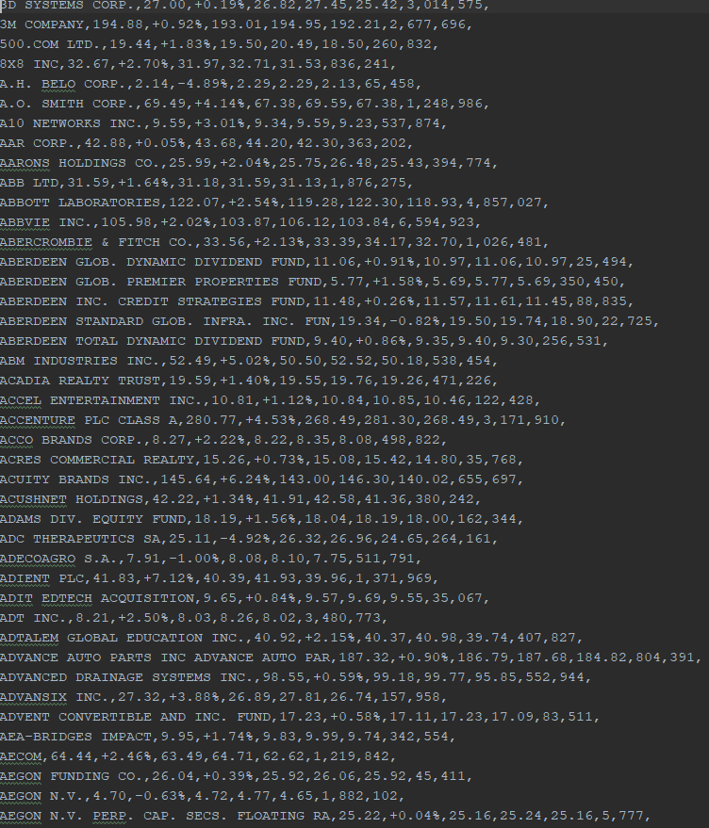
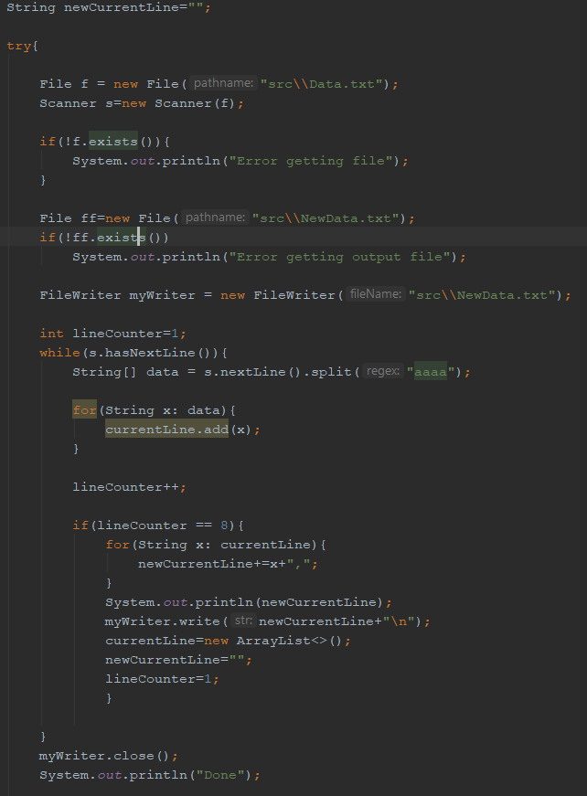
Processing
The cleaned text file had to be formatted so that it could be easily imported into a table
Created a Java file to reformat the text into a CSV file

Slide 8
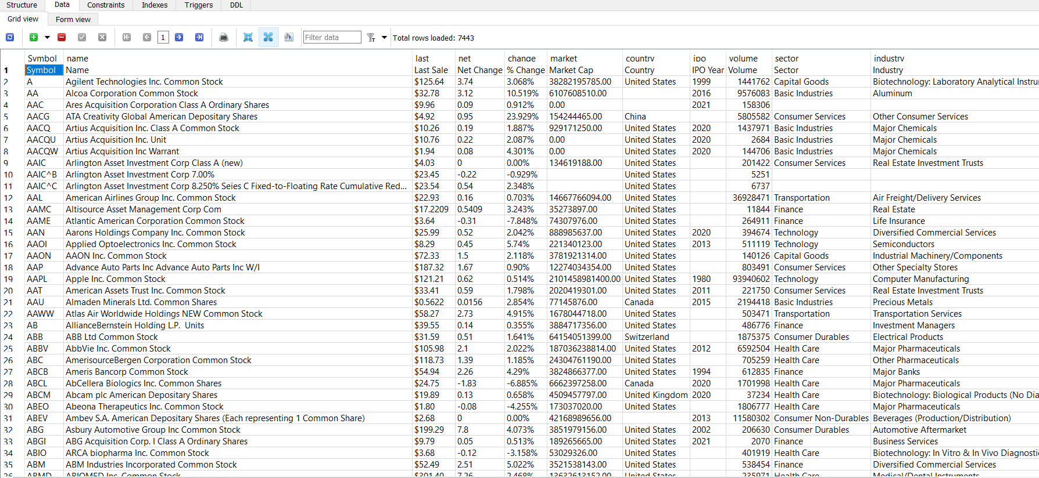
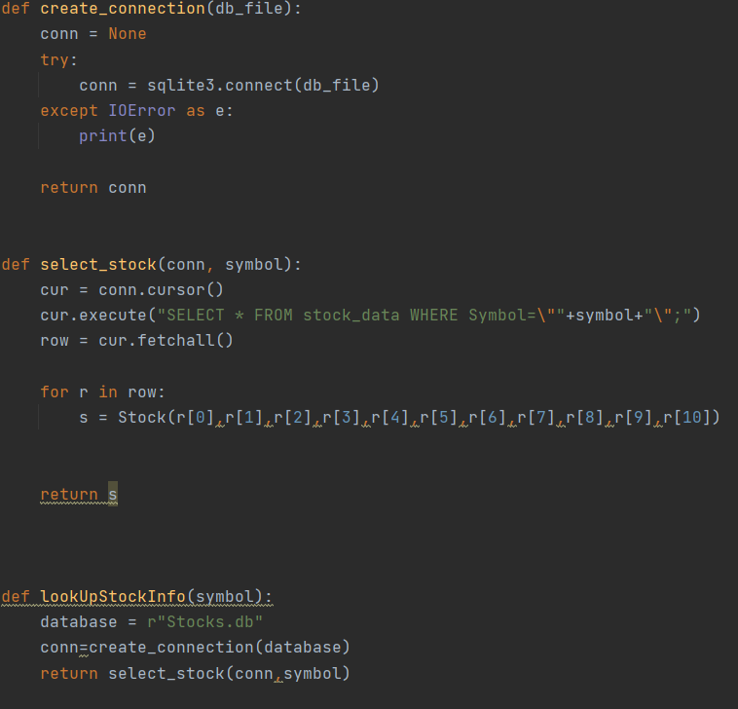
Database
Created a table in SQL to store the data in the most organized way
Imported processed CSV file into the table
Created Python script to query the database and send results to the GUI

Slide 9
User Input
Takes the Ticker of the stock the user wants to input
Outputs a graph of the stock, as well as some relevant data
Also displays the top five highest positively changing stocks of the day

Slide 10
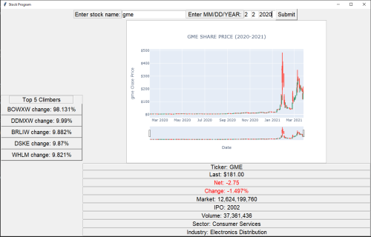
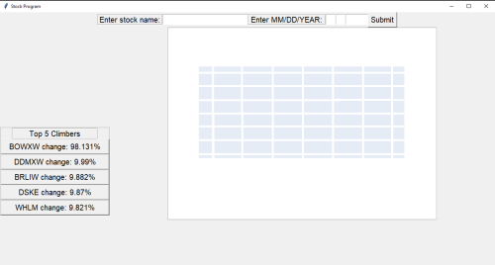
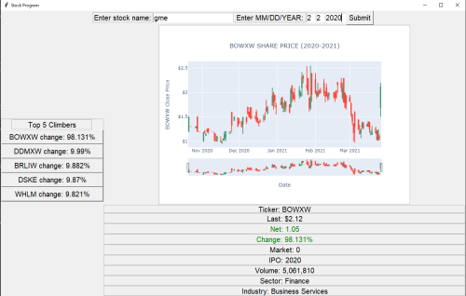
Finished Product
Screen starts off blank displaying only the ‘top 5 climber ‘ of the day
User inputs a ticker and date, then the relevant graph and information is displayed on screen
The graph and information is automatically cleared once a new ticker and date is entered

Slide 11
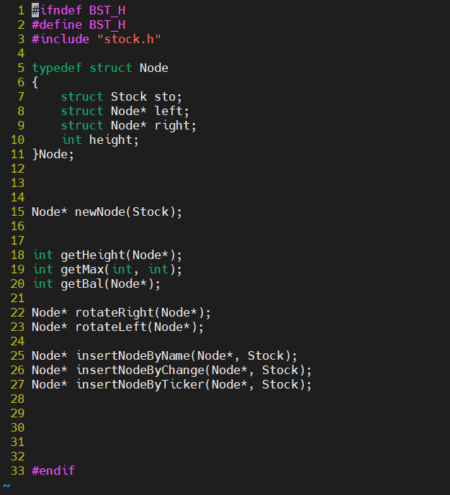
AVL Tree ROADBLOCK
Store the stock data in an AVL tree for quick storing and searching in C
easier to add a new stock as we did not know how many stocks we were using
This would have brought the search time complexity from O(n) to O(logn) compared to an array or linked list

Slide 12
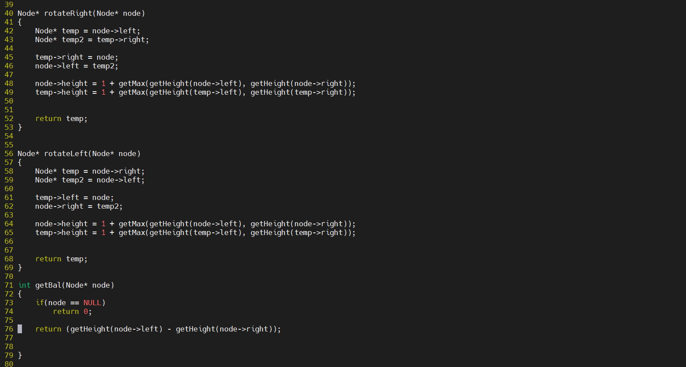
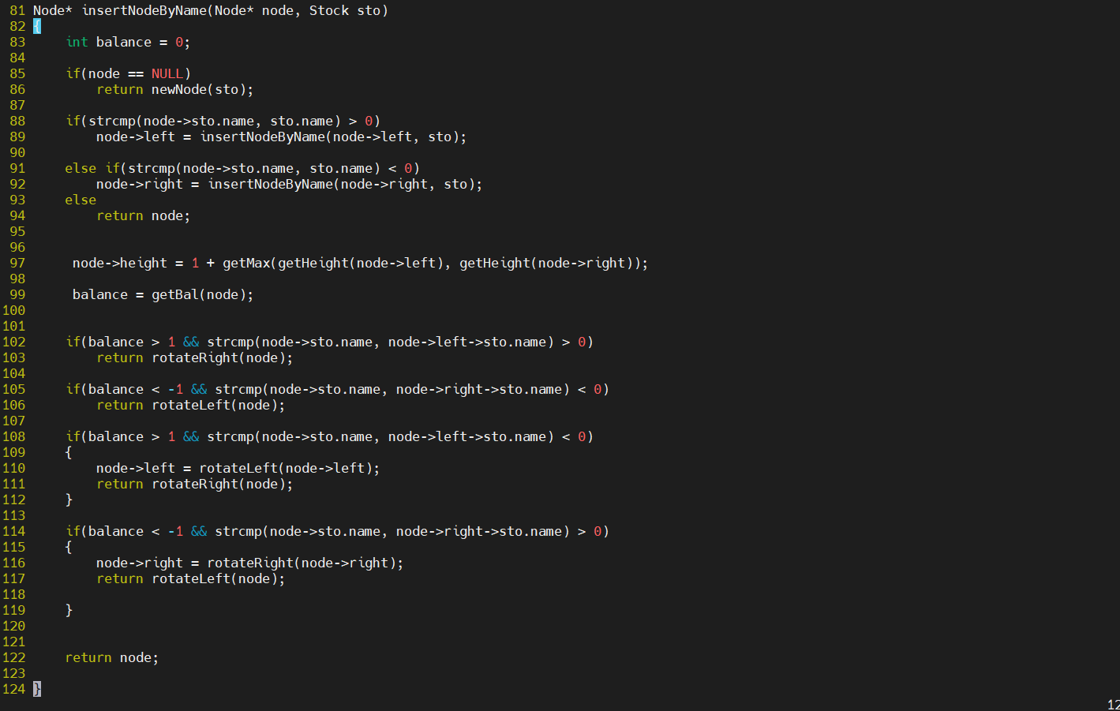
AVL Tree (Continued) ROADBLOCK
Each Node represented a Stock
The AVL tree was sorted by Alphabetical order, or by price
Initially going to have an AVL tree for, name, ticker, and price values

Slide 13
Files Created
Stock Data.txt - Cleaned Data from Web Scraping Process
Table Ready Data.csv - Processed, Table Ready data from Stock Data.txt
stocks.db - Database containing all stock information
TreeLoader.c - Load Stock Data into the tree
AVL.c - Functions to insert a Node and to create a Node
stock.h - Create the struct for the Stock, declared with data members of stocks
AVL.h - Create the struct for the AVL tree, and function prototypes
Main.py - Main project file, created graphs and displays information
Scrape.py - Script used to scrape stock data off the web and purge all unnecessary data
LookUpStockInfo.py - Script to use SQL queries on stocks.db

Slide 14
Closing Thoughts
Web scraping was a really fun and challenging topic. We’re happy to have chosen it as our project for our first webathon
Our end product is not exactly as we envisioned, but in the end we found a way to make it work. We are all quite proud with how it turned out

